Slide 1
Holland's six personality types
By:
  Shaimaa Hammad Youssef
  Zeinab Nabil Abdel Ghany
  Yomna Salah Attallah

Slide 2
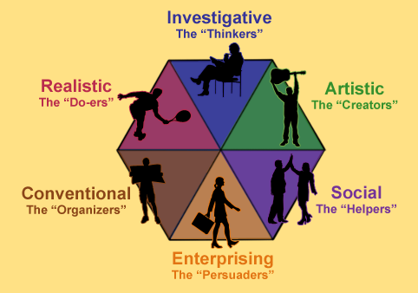
Holland's six personality types
Holland's six personality types are also known as RIASEC, which stands for Realistic, Investigative, Artistic, Social, Enterprising, and Conventional.

Slide 3
Holland's six personality types
Realistic (R): People who really enjoy working with their hands and like practical tasks. They are typically practical, down-to-earth, and prefer to work with machines, tools, or animals.
  Typical realistic careers include electrician, engineer, veterinarian, and the military.
Investigative (I): Investigative people enjoy working with theories and ideas. They are usually analytical, and curious, and prefer to work with data, numbers, and research.
  Typical investigative careers include medical technologist, biologist, chemist, and systems analyst.
Artistic (A): Artistic people are creative, imaginative, and often have a strong sense of aesthetics. They enjoy expressing themselves through various forms of art, such as painting, music, or writing.
  Typical artistic careers include musician, reporter, and interior decorator.

Slide 4
Holland's six personality types
Social (S): Social people are outgoing, friendly, and enjoy working with others. They often have good communication skills and are helpful in assisting others.
  Typical social careers include teacher and social worker.
Enterprising (E): Enterprising people are assertive, confident, and enjoy taking on leadership roles. They are typically outgoing, and persuasive, and enjoy working with people to achieve common goals.
  Typical enterprising careers include salesperson, business executive, and manager.
Conventional (C): Conventional people are organized, detail-oriented, and enjoy working with systems and procedures. They prefer structured and predictable work environments and enjoy following established rules and procedures.
  Typical conventional careers include secretary, accountant, and banker.

Slide 5

Holland's six personality types
Holland's personality types are often used to assess career choices and work environments that best match an individual's personality type.

Slide 6


